Slide 1


VISION WORKBOOK
2022
Greater Missouri Leadership Challenge
a guide to living your purpose

Slide 2

Live your purpose.
Setting intentions for the year is the most impactful way we can invest in ourselves. It’s up to each of us to set our direction and know where we’re headed.
Focus DAILY on your top priorities.
Create ENERGY to propel you forward.
Visualization + Doing the work =
the secret sauce to success.
KNOW YOUR WHY

Slide 3

2022 Mantra
Be the energy you want to attract.
Choose a quote, scripture, word, or sentence that you look at each morning to inspire your day. Write it here.

Slide 4

Imagine yourself at the end of the year and describe it here…
Where are you?
Who are you with?
How do you feel?
What are your priorities? What does "success" look like for you?
This vision will guide the rest of the deck...
Visualize

Slide 5

How I want to feel.
At the beginning of the year, I make a list of emotions that I want to feel. I review it each morning and ask, “How can I feel more of these today?” It’s amazing how setting an intention for the way you want to feel changes the way you carry yourself through the day. Here are some of mine--use this space to write your own.
Attention goes where energy flows.
fully present
living my truth
free
joyful
grateful
energized

Slide 6



Ireland
Alaska
Echo Bluff State Park
Where I want to go.
Think of a few spots on your travel wish list and write them here. It could be a weekend road trip or a dream international adventure. It’s okay if you don’t check them all off your list this year--it's about setting intentions for places you want to experience, whether it’s now or later. These are mine--replace them with your own.

Slide 7
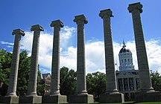
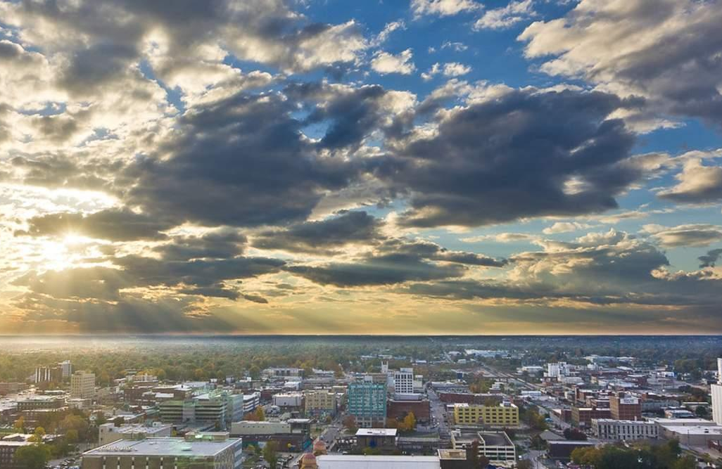
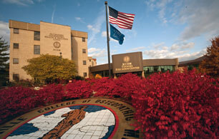
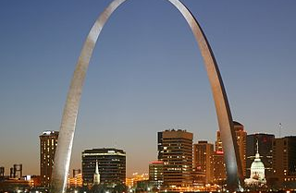
Columbia/Jefferson City
March 1-3, 2022
Springfield
June 8-10, 2022
Kirksville
September 7-9, 2022
St. Louis
November 2-4, 2022
Where WE will
go.
The connections you make during each Greater Missouri Challenge Session will inspire. Put these sites and dates on everyone’s calendar who needs to know you will be enhancing your training and development with intention.

Slide 8

For the last few years, I’ve kept a list on my phone of the 10 or so people (outside of my family) I most want to prioritize, no matter how busy life gets. I review it as a checkpoint to make sure I’m supporting and staying connected to the people who matter most to me. A glance at this list reminds me to check in.
Make a list of the friends, co-workers, neighbors, session speakers, alumnae, etc. who you want to prioritize this year–keep it short so you can really invest in each of them.
People I want to prioritize.

Slide 9



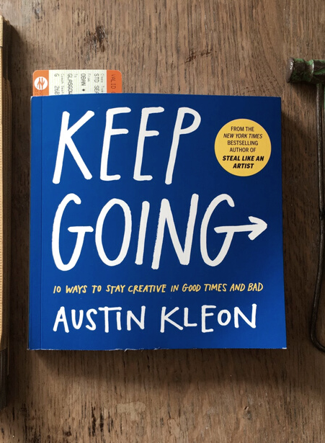
Bird by Bird
by Anne Lamott
Peace is a Practice
by Morgan Harper Nichols
A Place for Us
by Fatima Farheen Mirza
Keep Going
by Austin Kleon
Books I want to read
I like to set an intention at the beginning of the year for a few books that I want to read start-to-finish. Four means one book a season--feel free to get ambitious and up your number to one a month.

Slide 10

I will learn to surf.
Choose one thing you want to learn to do this year.

Slide 11
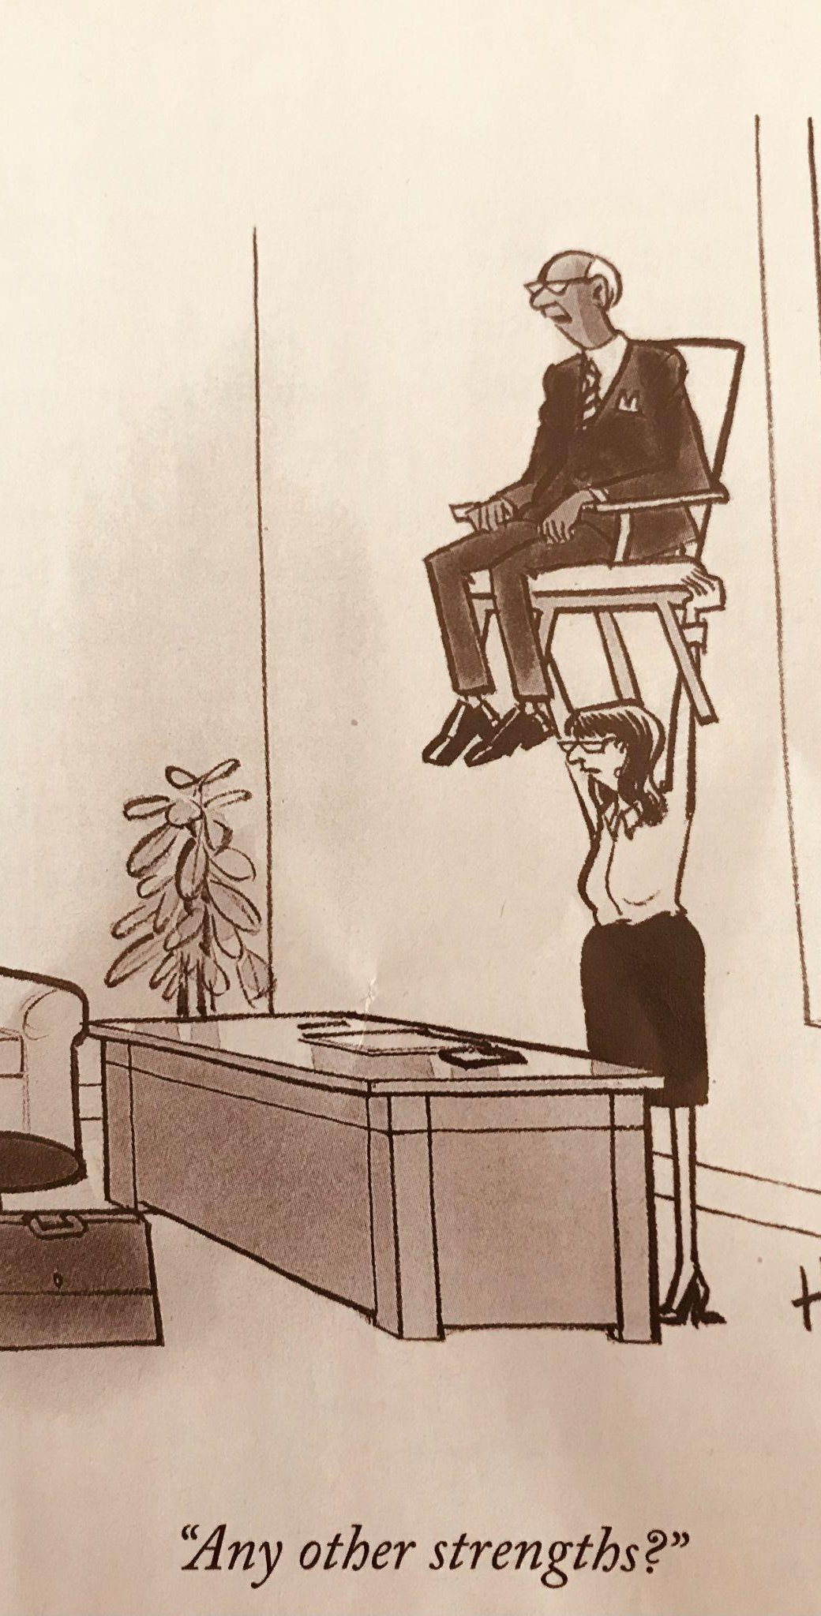
Maximize Your Strengths
Learn the importance of embracing your unique strengths, knowing how to pivot, and seeking trusted guidance through our Gallup’s Clifton Strengths conversations.

Slide 12







Ready to set some transformative goals?
Relationships
Career
Health
I choose just ONE goal for each "zone" of my life, along with the ONE action item that will make the most traction towards that goal. This method keeps it specific, while taking a holistic view that encompasses the different parts of myself that I want to keep developing.
Personal Growth
Spiritual / Emotional
Financial

Slide 13

Write one thing you want to experience in your relationships--it might be family, romance, or friendships.
my example: Practice deeper listening with my kids.
Make it happen: Write one step you can take that will make the most impact towards that goal.
my example: When my kids are telling me something, put away my phone and make eye contact.
Relationships

Slide 14

Write one thing you want to experience in your creative pursuit.
my example: Cultivate interior design best practices to create spaces to express myself creatively.
Make it happen: Write the one step you can take that will make the most impact towards that goal.
my example: Utilize automation to meet goals at the desk, in the kitchen, on stage, anywhere!
Creativity

Slide 15

Write one thing you want to experience in your career.
my example: Cultivate my communication skills to connect more authentically with GMLF community.
Make it happen: Write the one step you can take that will make the most impact towards that goal.
my example: Study persuasive speakers.
Career

Slide 16
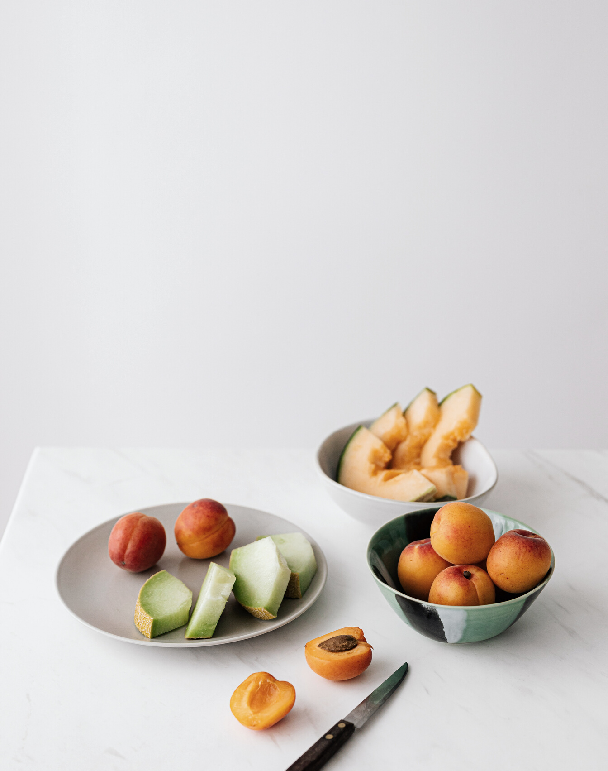
Write one goal for your physical health and well-being.
my example: Bring more mindfulness to my meals.
Make it happen: Write the one step you can take that will make the most impact towards that goal.
my example: When I sit down to eat, take 3 slow, deep breaths before I take my first bite.
Health / Wellness

Slide 17

Write one way in which you want to grow and develop as a person.
my example: Bring more fun and excitement to everyday experiences (ie break out of the rut.)
Make it happen: Write the one step you can take that will make the most impact towards that goal.
my example: When I'm bored, use that feeling as a reminder to bring my full presence to whatever I'm doing, raise my energy and enjoy life!
Personal Growth

Slide 18
Write one way you want to deepen your spiritual practice and/or emotional health.
my example: Enjoy nature’s abundance in the smaller, day-to-day experiences of life.
Make it happen: Write the one step you can take that will make the most impact towards that goal.
my example: Set an alarm at two different points in my day to stop for a minute and smell the roses.
Spiritual / Emotional

Slide 19

Write one goal for your finances--saving, paying off debt, or giving.
my example: Organize all our financial documents in one consolidated place.
Make it happen: Write the one step you can take that will make the most impact towards that goal.
my example: Create a secure digital home for all records, assets, insurance and house info, along with twice yearly review meetings.
Financial

Slide 20



“You only need to know the direction, not the destination. The direction is enough to make the next choice.”
— James Clear
“A year from now you will wish you had started today.” — Karen Lamb

