Slide 1


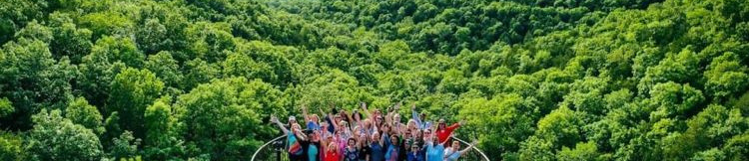
Greater Missouri Leadership Challenge
Session II, Springfield and Branson
THE CLASS OF 2022

Slide 2










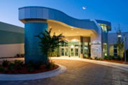





Greater Missouri Leadership Challenge SPONSORS
PLATINUM
SESSION
SESSION II, CLASS OF 2022

Slide 3
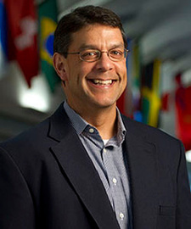
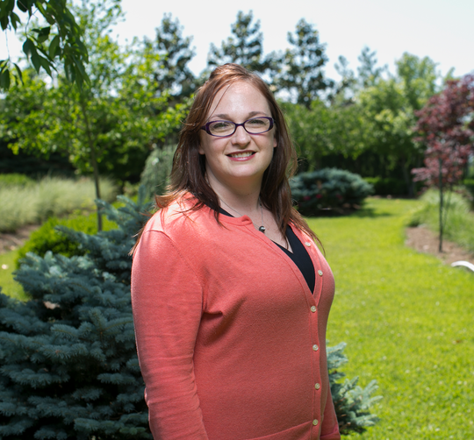
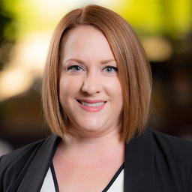
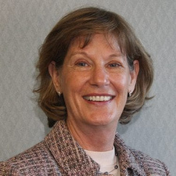
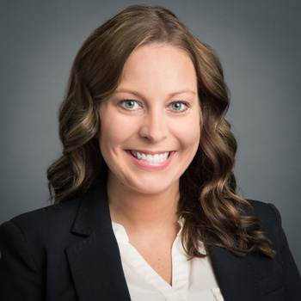
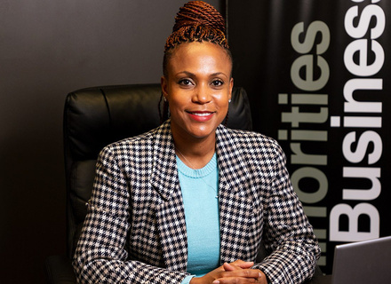
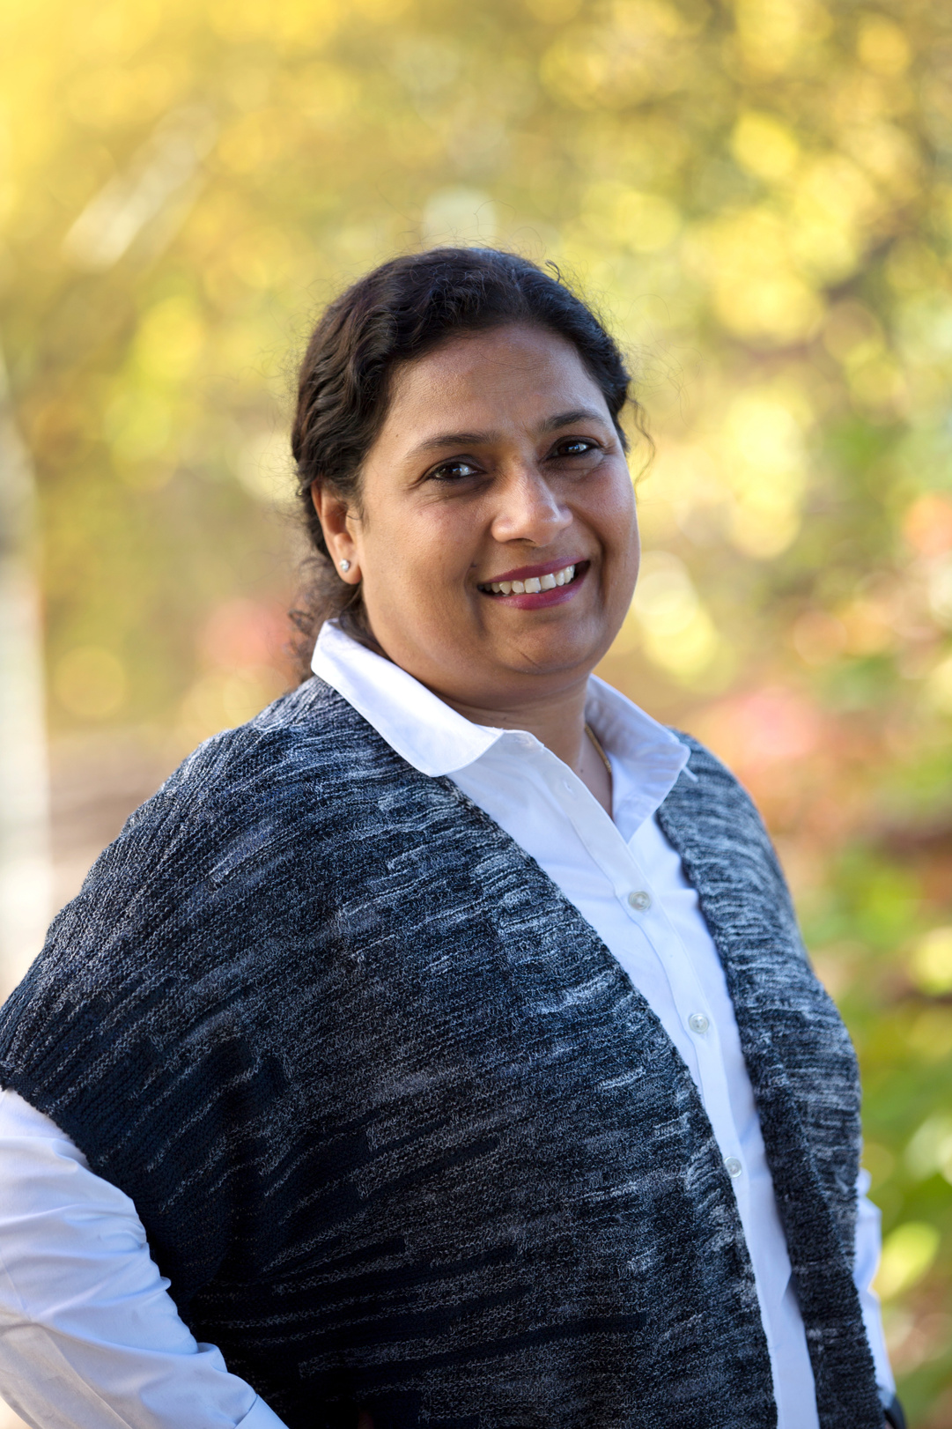
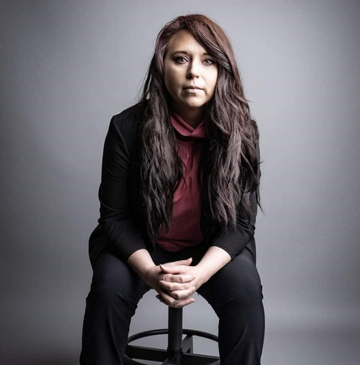
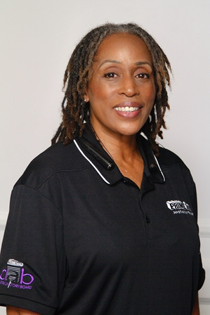
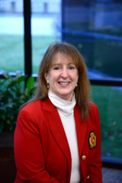
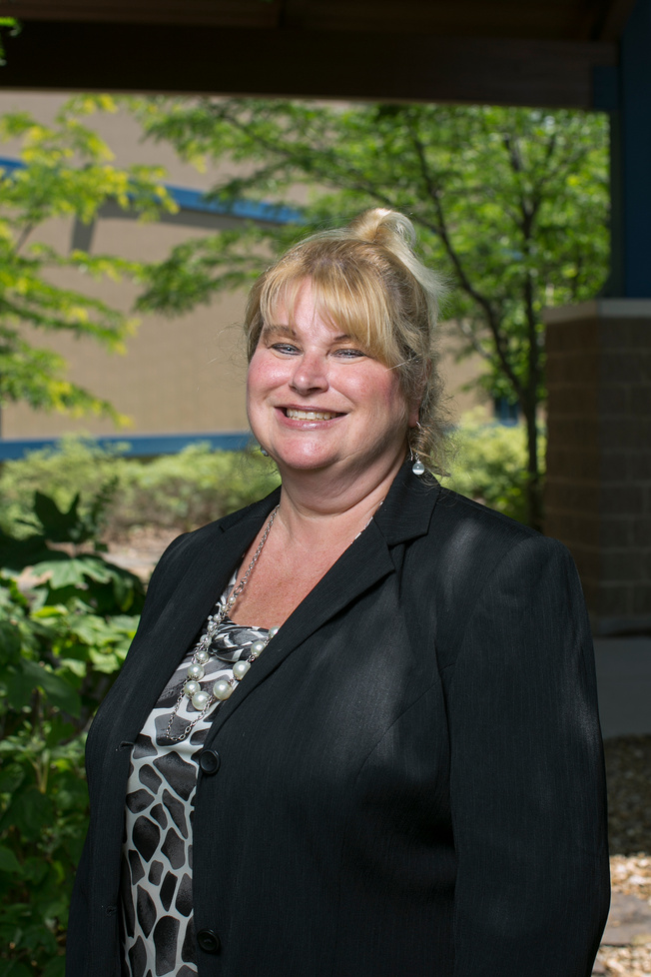
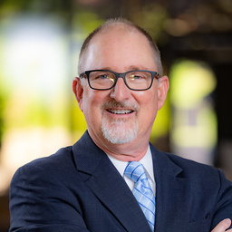
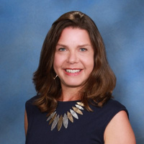
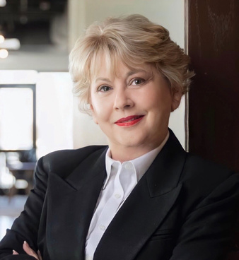
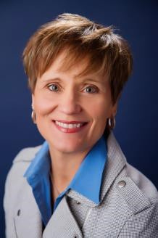
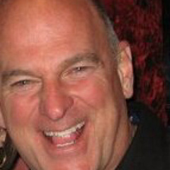
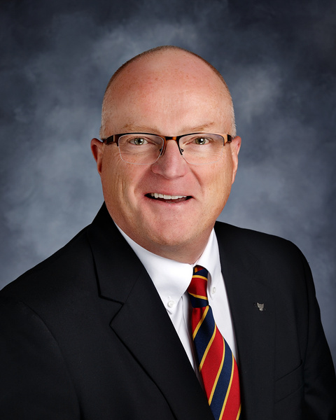
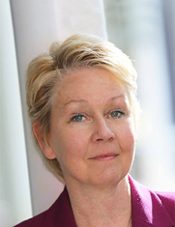
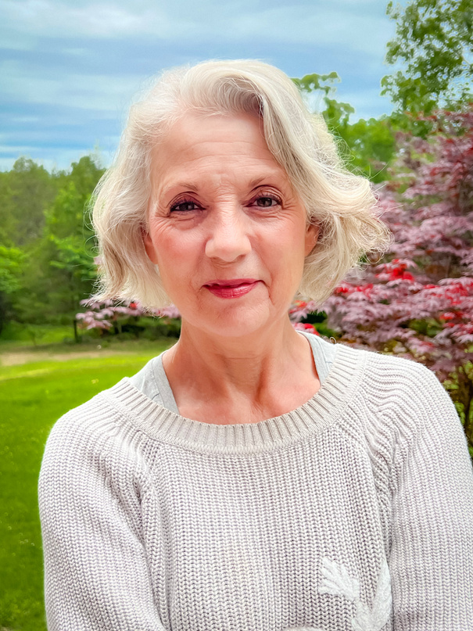
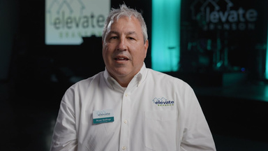
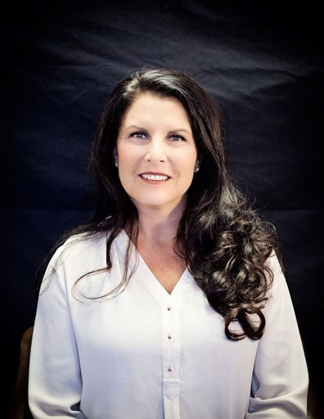
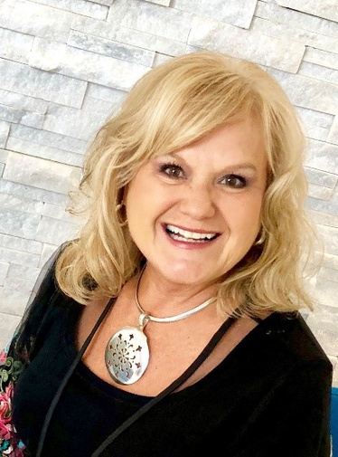
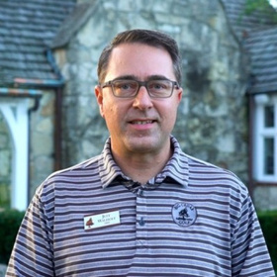
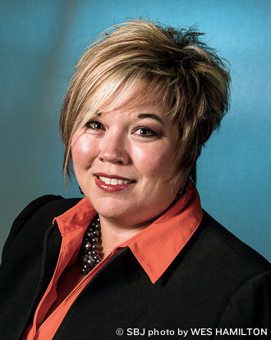
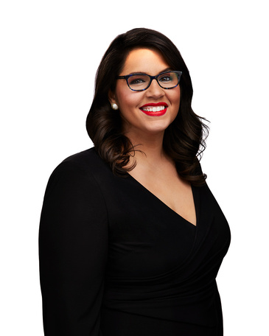
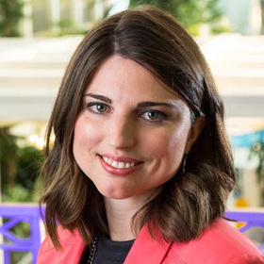
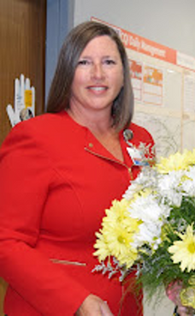
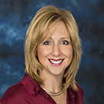
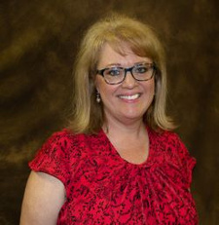
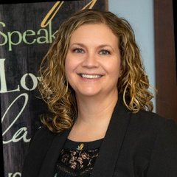
Thank You to our
Session II Speakers!

Slide 4
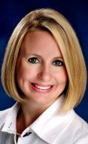
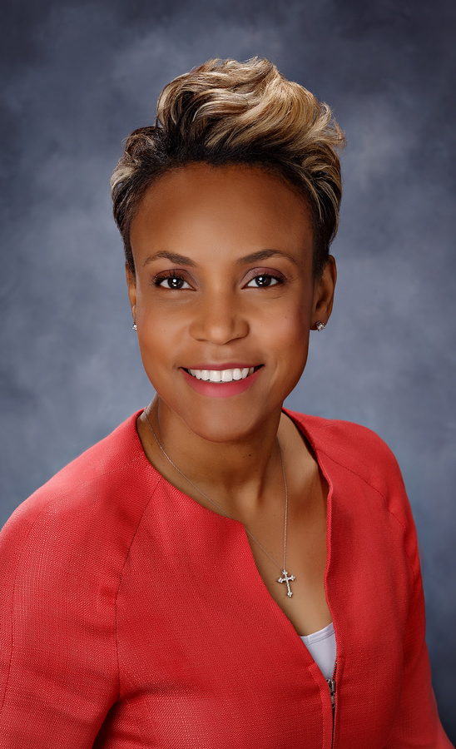
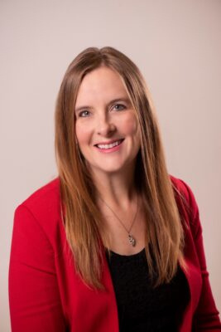
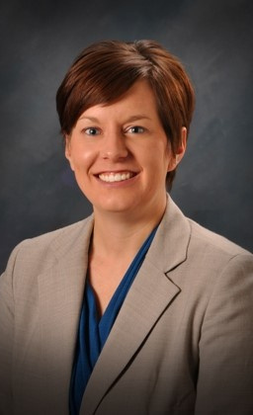
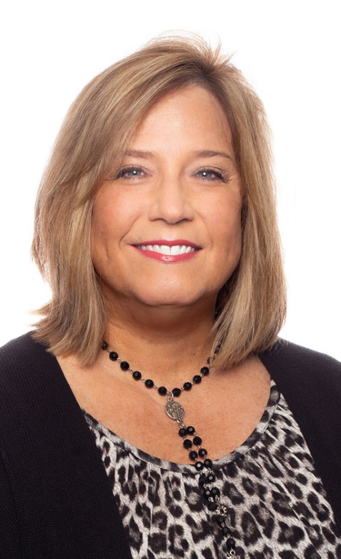

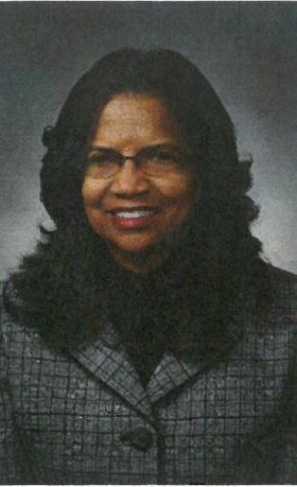
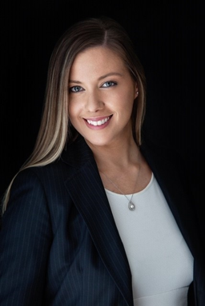
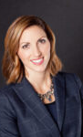
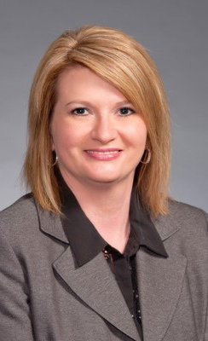
Thanks to our Planning Team
Bus Captain!

Slide 5
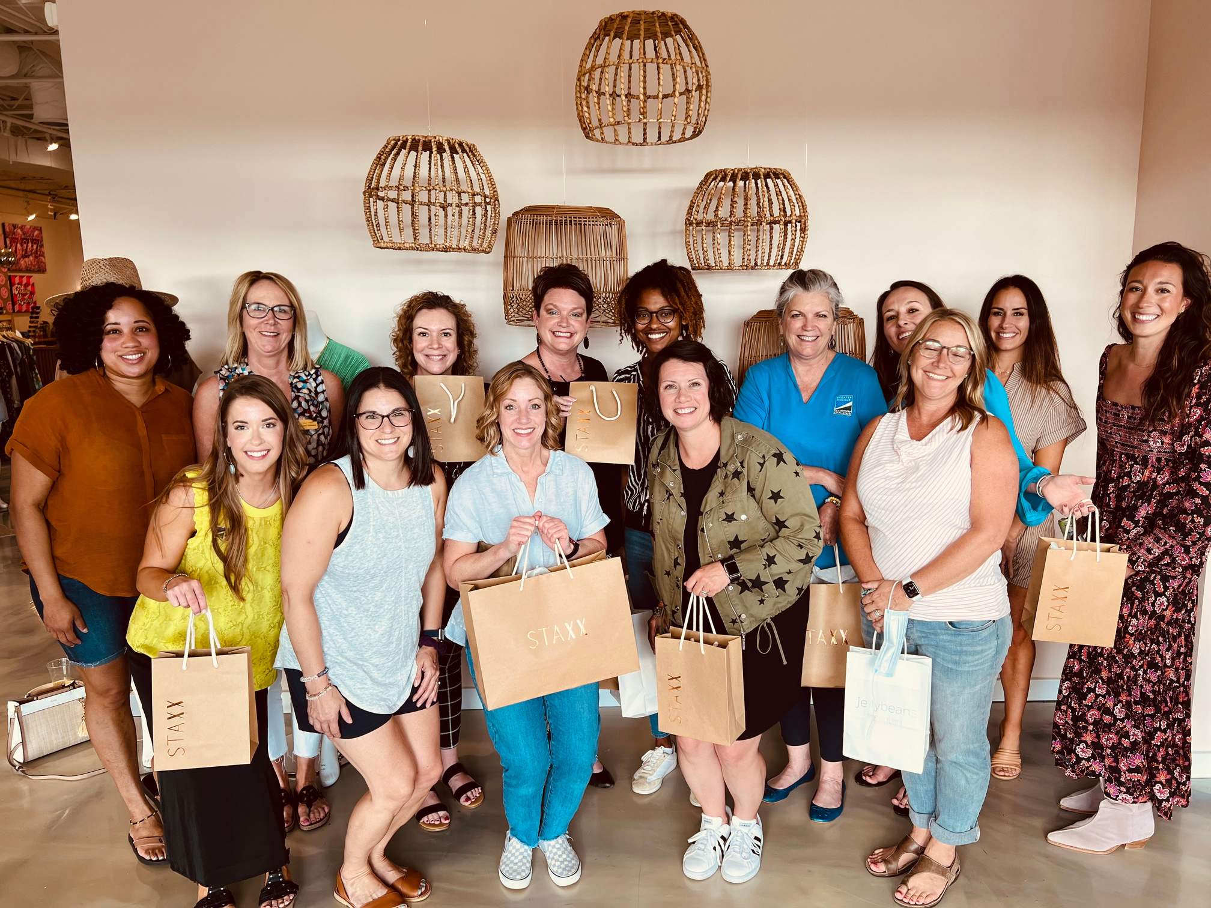
Greater Missouri Leadership Challenge
Pre- Session with Area Alumnae
Shopping at STAXX
SESSION II, CLASS OF 2022

Slide 6
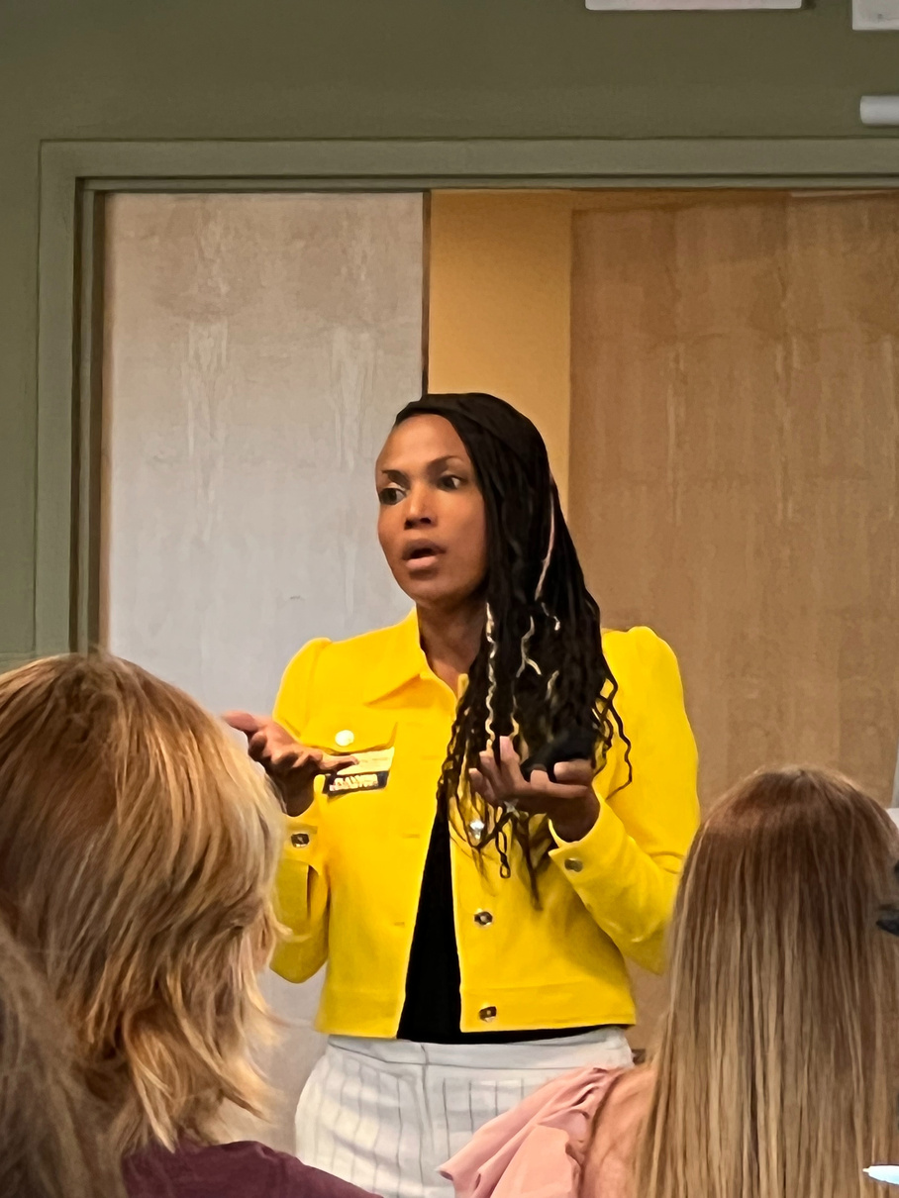
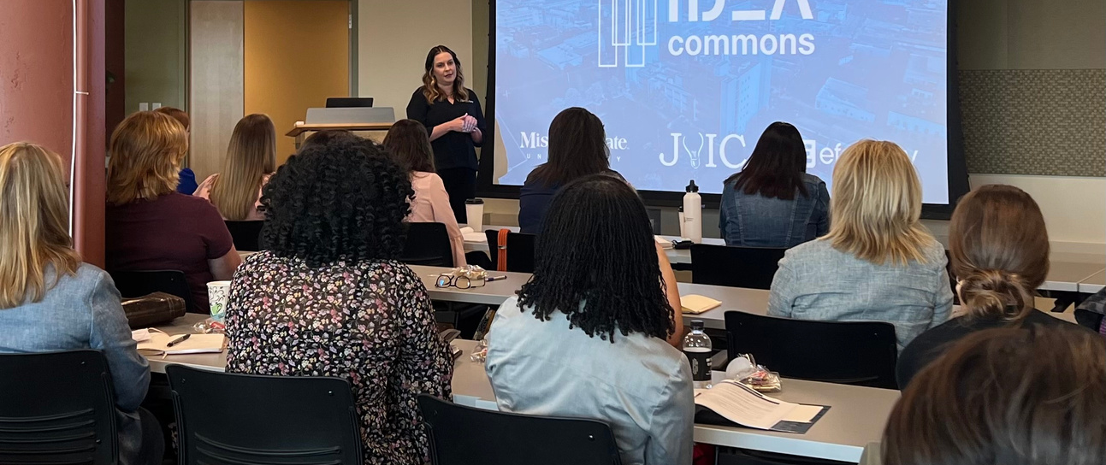
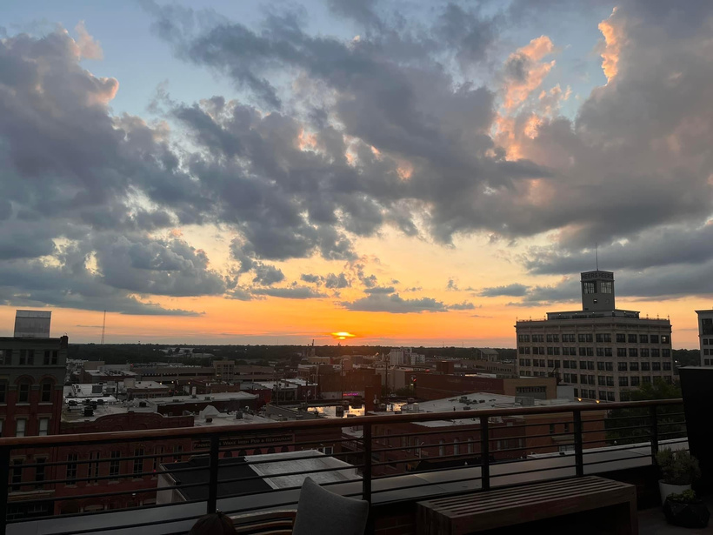
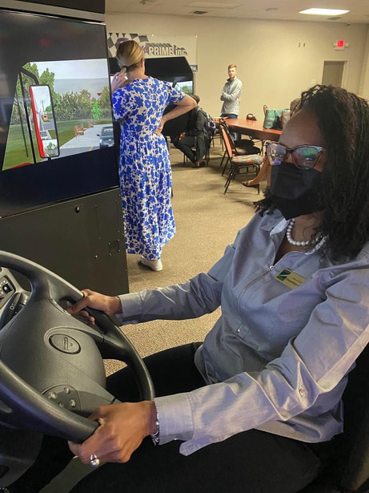
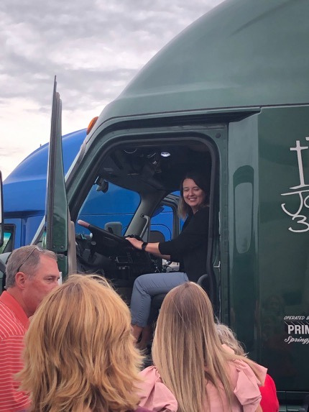
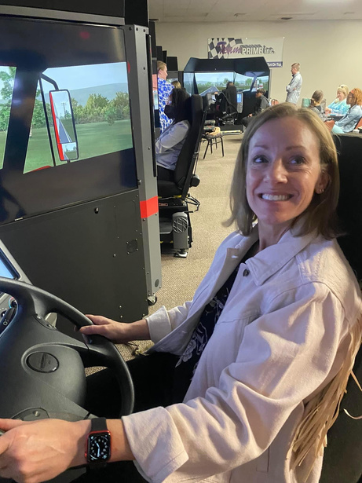
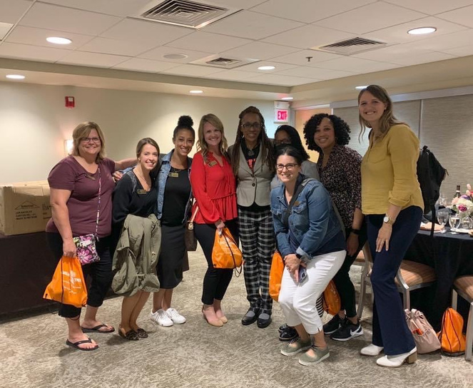
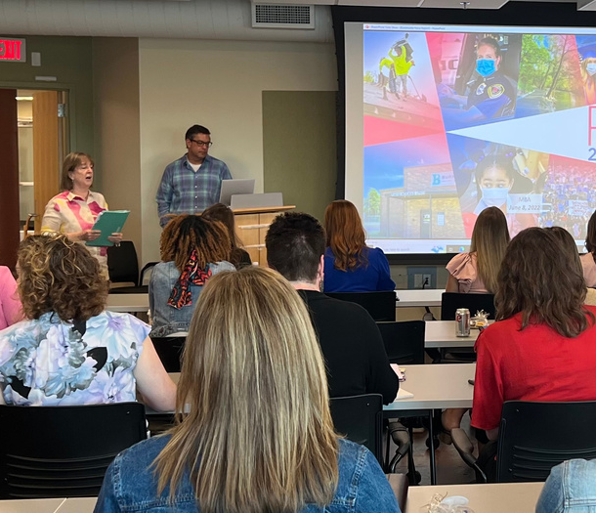

DAY ONE
SESSION II - SPRINGFIELD

Slide 7

GREATER MISSOURI LEADERSHIP CHALLENGE
Such great stories and so powerful!
WOW! Great Women with Inspiration and Passion
I loved hearing the journeys of these women and the work that they're doing today.
Good stories, I would have liked to see them have more of a 'speech' or takeaways though. It seemed like they got up to talk informally, if they were going to do that, it would have been better to have been seated for a 'panell
Loved hearing their journeys, their struggles, and how they got where they are today in a male dominated field. Left me feeling inspired and also a little stuck in my current position.

Slide 8
Greater Missouri Leadership Challenge
Great day 1 Set the Stage for an uplifting learning experience.
An impactful day. Everyone experienced something they could relate to.
Honestly, I had very little expectation around the Prime/trucking tours but I found the afternoon to be very interesting! The simulation was really fun to jump into.
GREAT day. Also, the grab and go breakfasts were super nice. Appreciated this approach. With plenty of coffee and waters!
Inspirational women who fought for a seat at the table
WOW! WOW! Again, this was so vulnerable and impressive. How many tears did we all shed?? How many laughs did we laugh??
Thank you for allowing us time, without presentation, to chat with our cohort members and discuss on our day.

Slide 9















Day Two
Branson

Slide 10

Greater Missouri Leadership Challenge
Mary
I wish she had more time to share as her experiences were beyond the ordinary. Think of how she has adapted from the big stage to this community. There might be more to her story that she didn't get into.
A gem. Amazing. What a story!
OMG SO FREAKING INSPIRING! TOOK A LOT OF POSITIVE INFORMATION AND PUSH FROM HEARING HER TALK. FOR SURE WILL BE STEPPING UP MY GAME AS AN ENTREPRENEUR
More speakers like this! Strong and powerful with a nationwide experience of impact.
Could've spent all day with her! She is incredible. Hated that her time was cut short. Hoped to have been able to hear all she had prepared to talk to us about. Does she accept interns? I feel I could learn so much to transfer to my career and job.
SESSION II, CLASS OF 2022

Slide 11






Taking this "challenge" experience rogue

Slide 12
Loved being outside and doing things as we were learning. It was way better than being inside of a classroom the entire time.
Loved the red carpet treatment we received all day long! I didn't expect that.
Super high energy and appreciated everyone's extensive knowledge of the history.
The only reason I wouldn't rank this a higher score is for how long the day was. Understandably want to get as much as you can into an agenda but 14+ hours is too long.
The hospitality was great. Also the discussions. Opened my eyes to area's challenges.
Erin Hayes-Dennis' story was impactful to me and I hope many others of my classmates. "Life is Difficult" -- that is a message that can be applied to all, and she delivered her message so eloquently.
This was amazing but too long. Dinner needed to be done earlier and then enjoy sunset ceremony. Way too much packed into a very long day. My stamina must be waning!
High scores all around. Unbelievable back of the house access and generosity of hosts and sponsors.
Great time for connections with our class. I can see now how that informal networking is going to help me, my career, and my future.
I will be back. Excited to return to be able to share with my family.
Appreciated Lisa and Ann's passion, loved the overview and inspiration-liked it when speakers (Brad, Mary) focused on
WOMEN LEADERSHIP.
Greater Missouri Leadership Challenge

Slide 13






Day Three
Springfield

Slide 14
Greater Missouri Leadership Challenge
I LOVE getting to see Boy's and Girl's clubs and see how they address the needs of the students in their community.
I loved hearing about the work that these groups are doing. Wish we had more time as, per the usual, we had a lot of questions. And these inspiring leaders best practices can be adapted to my future volunteer work.
Great- good amount of time for all events. Really came together nicely.
All speakers were GREAT! They all carry a heavy load to help the community. It was so great to get to talk to them and see how they collaborate to address the needs of each of their organizations.
These ladies were amazing and it was good to see how they are working together to address the community needs.
KNOCKED IT OUT OF THE PARK. Easily one of the best day of discussions I've ever had the chance to experience. They were all so well-spoken, passionate about their organizations, had clear ideas of what support they needed/what steps they needed to tackle to better support their clients. I was really blown away by how impactful this discussion was. Some of the stats they shared were absolutely heartbreaking, but at the same time, so eye-opening as to how things like the pandemic and the wealth/racial divide in the area have impacted the community.

Slide 15


Greater Missouri Leadership Challenge
Home of the original Springfield Style Cashew Chicken
I I had no idea.
Loved that HE came and shared the family's inspirational story.
This cultural insight into the community was a welcome surprise. o idea
SESSION II, CLASS OF 2022

Slide 16
IMPACTFUL!
MOTIVATING!
Greater Missouri Leadership Challenge
Grateful
ENGAGING
LIBERATING!
incredible
"You are halfway through the Challenge-
Describe your experience"
dream
WOW!
HUSTLE
I can
Empowering
&
I will
inspiring
ACTION
Realization
Transformational
inspired
I have been amazed by the networking and learnings offered in each session.
This is an incredible group of women and the exposure offers unending opportunities for career and civic growth.
SHINE
Great!
BE
BRAVE
SHINE
SESSION II, CLASS OF 2022
Informed
SHINE

Slide 17


Greater Missouri Leadership Challenge
June 8-10
Class of 2022
SESSION II, SPRINGFIELD & BRANSON

